Slide 1

Strategic Pricing & Revenue Optimization
Big Mountain Resort Executive Briefing

Slide 2
Identifying the Revenue Gap
Market Analysis & Value Misalignment

Slide 3

Infrastructure vs. Price Disparity
$81
$95.87
→
Current Ticket Price
Market-Supported Value
Our model indicates that Big Mountain is currently underpriced by 18% relative to its superior facilities.

Slide 4

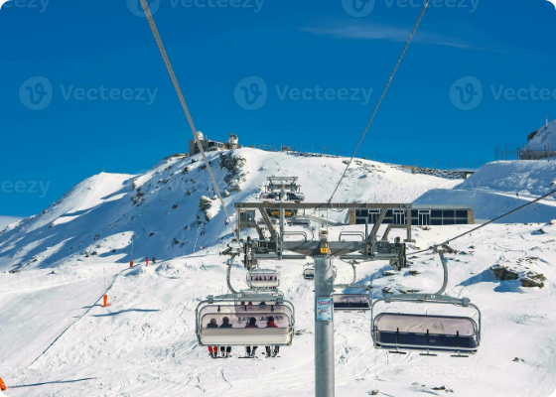
Leading the National Market
Premium Assets
Big Mountain ranks in the top percentiles nationwide for infrastructure:
•
Vertical Drop: 2,353 ft (Top Tier)
•
Snowmaking: 600 Acres (Market Leader)
•
Total Chairs: 14 (Industry High)
We are delivering a top-tier experience at a mid-tier price point.

Slide 5
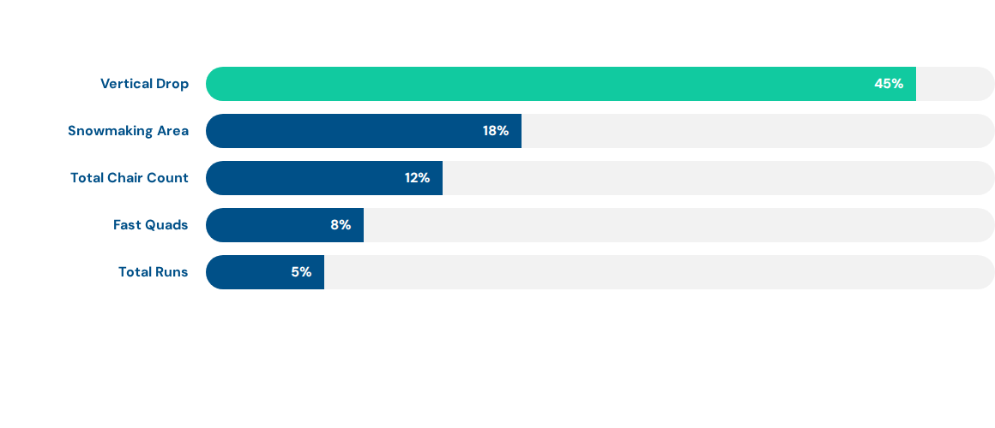
Value Drivers: Feature Importance
*Analysis based on Random Forest Regression of 277 US resorts. Vertical drop and snowmaking represent 63% of the supportable price weight.

Slide 6
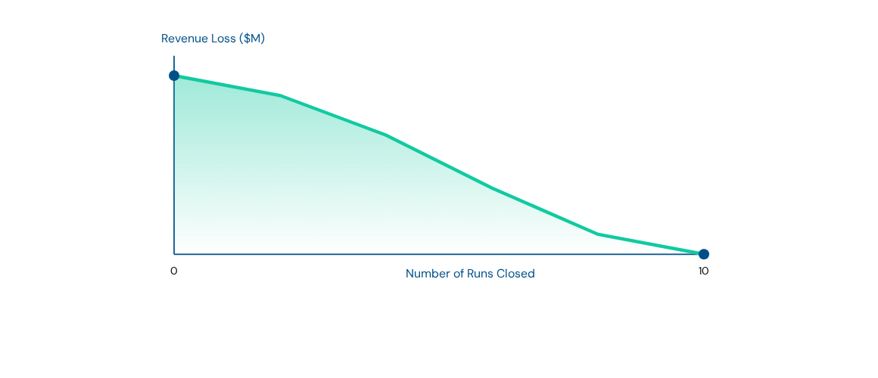
The Cost of Operational Reductions
Closing runs results in a steep non-linear drop in supportable ticket price. Every run counts toward our premium positioning.

Slide 7





Strategic Pivot: Recommendation
Price Adjustment
Season Length
Capital Wisdom
Increase ticket price to $94.00. This remains conservative against the predicted $95.87 market value.
Prioritize staying open. One additional day represents $1.73M in incremental revenue.
Cease snowmaking expansion. At 600 acres, further investment yields $0.00 additional price support.

Slide 8
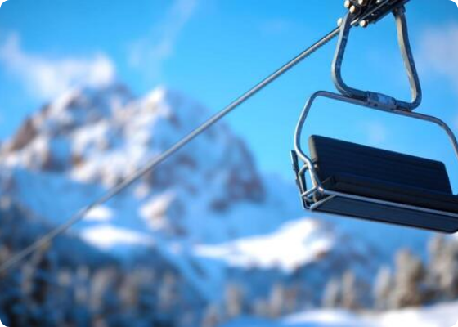
Summary & Conclusion
Alignment: Synchronize pricing with our world-class infrastructure.
Efficiency: Utilize existing snowmaking to extend season, rather than increasing acreage.
Defense: Maintain all 105 runs to protect our premium status.

Slide 9


Image Sources
https://static.vecteezy.com/system/resources/previews/023/508/162/non_2x/beautiful-view-of-gornergrat-zermatt-matterhorn-ski-resort-in-switzerland-with-cable-chair-lift-transportation-ski-lifts-in-switzerland-winter-holidays-photo.jpg
Source: www.vecteezy.com
https://static.vecteezy.com/system/resources/thumbnails/069/932/417/small/empty-ski-lift-chair-against-snowy-mountain-backdrop-photo.jpg
Source: www.vecteezy.com

